Slide 1

Agent-Based Task Fulfillment Chatbot
By S Chin’ombe, T Kachepa, I Madhara

Slide 2
MOTIVATION
Motivation
Modern customer systems require users to:
navigate multiple interfaces
perform repetitive actions
manually manage state (balance, orders, confirmations)
Problem
Naively connecting an LLM to real-world actions causes:
hallucinated state
unsafe execution
inconsistent data
lack of auditability
Goal
Design a safe, reliable agent-based chatbot that can:
reason over multi-step tasks
interact with external systems
maintain consistency and correctness

Slide 3
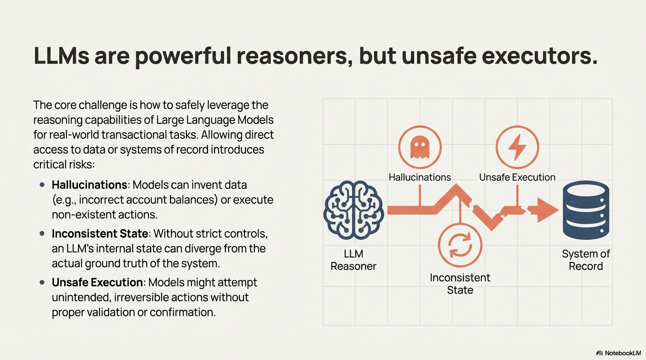
CORE IDEA
Notes:
Key Insight
Large Language Models should control actions, not execute them directly.
This prevents hallucinations and unsafe behavior.
LLMs act as controllers, not executors
All real actions go through deterministic tools
Database is the single source of truth

Slide 4
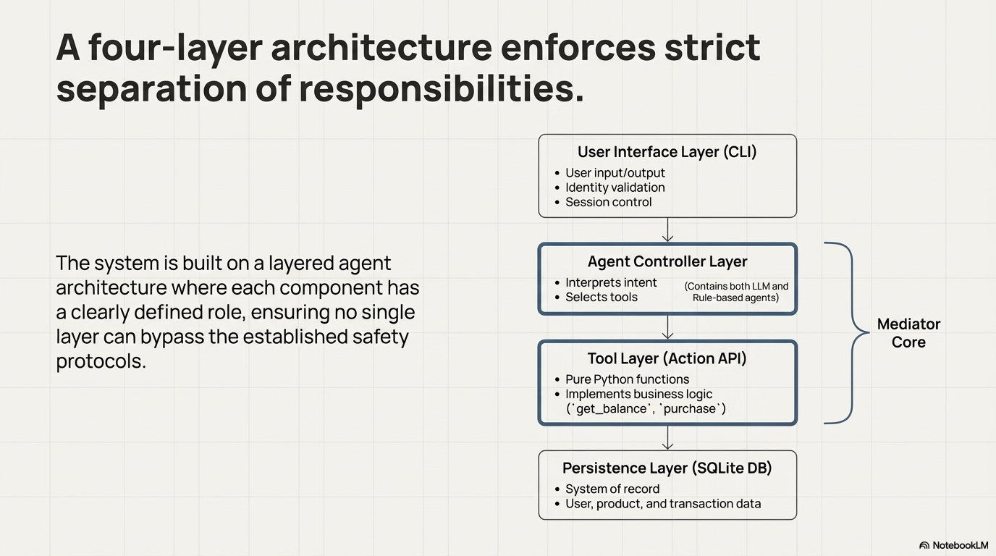
HIGH-LEVEL ARCHITECTURE
Notes:
User → Agent → Tools → Database
User sends natural language
Agent decides which tool to call
Tools execute business logic
Database persists state
Results flow back up to the user
⚠️ The LLM never writes to the database directly.

Slide 5
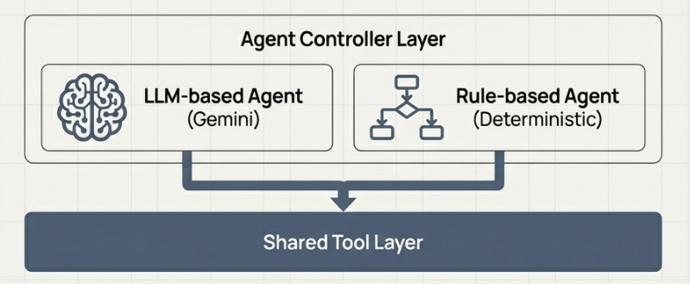
AGENT CONTROL LAYER
Rule Mode: deterministic baseline
LLM Mode: Gemini tool-calling
Auto Mode: Gemini → Rule fallback on failure
Notes:
ModeDescription
Rule Deterministic, no LLM (brittle)
LLM Gemini controls tool invocation in flexible natural language
Auto Guarantees intelligence and availability

Slide 6
Tool Layer
Tools are pure python functions for this project.
Examples of tools include Balance lookup, Product search, Purchase execution etc

Slide 7
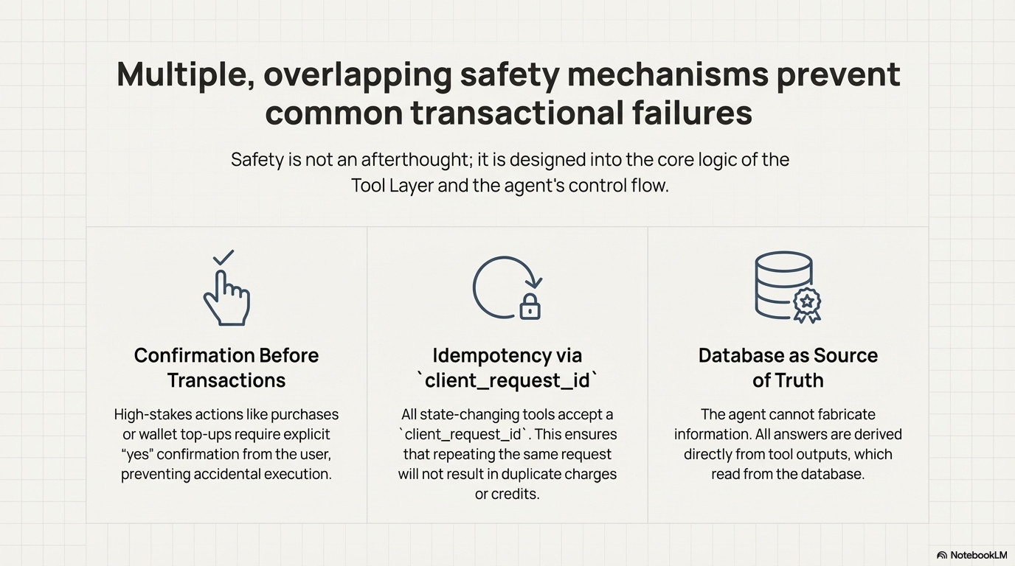
Safety Mechanisms
Notes:
Transaction Safety
Explicit confirmation before purchases
Explicit confirmation before wallet top-ups
Idempotency
Each transaction has a client_request_id
Prevents double charging on retries
Control Safety
No implicit session termination
Explicit exit required
LLM cannot modify DB directly

Slide 8
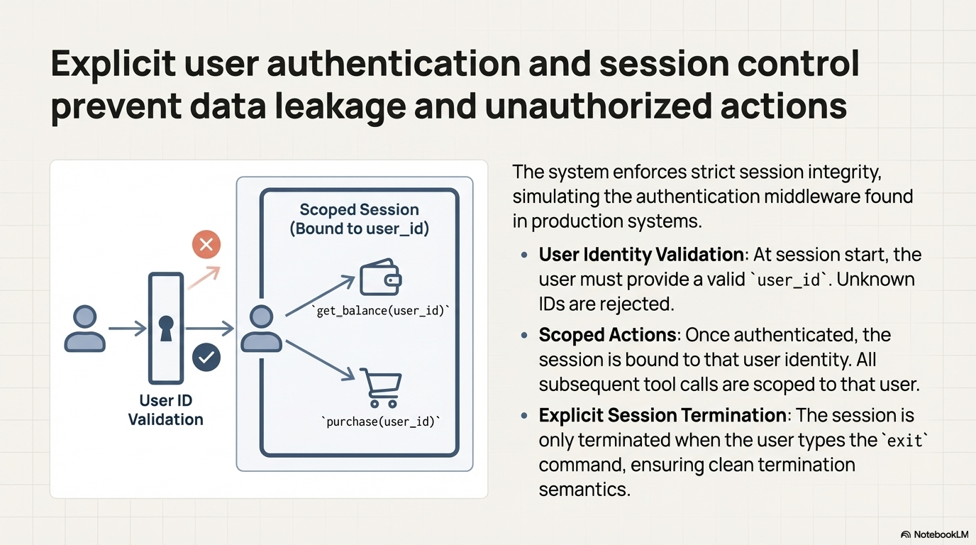
Safety Mechanisms
Notes:
Transaction Safety
Explicit confirmation before purchases
Explicit confirmation before wallet top-ups
Idempotency
Each transaction has a client_request_id
Prevents double charging on retries
Control Safety
No implicit session termination
Explicit exit required
LLM cannot modify DB directly

Slide 9
Auditability
Ledger of credits and debits
Order history verification
DB audit proves correctness

Slide 10
Evaluation
Automated scripted tests
Rule-based reproducibility
Pass/fail summaries

Slide 11
DEMO

Slide 12
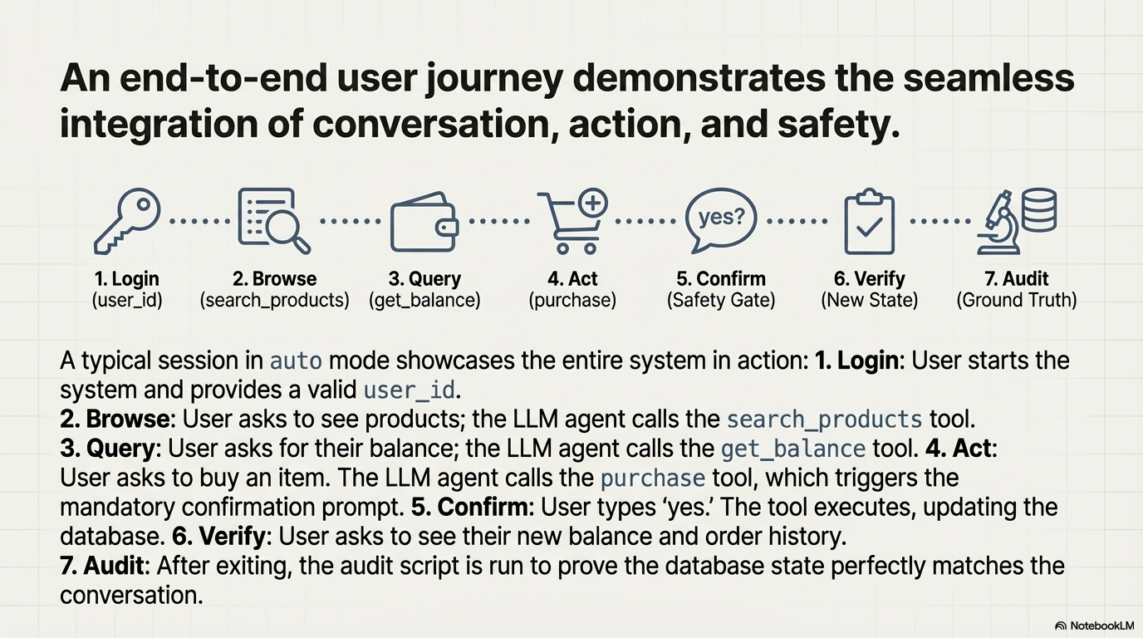
Conclusion
Notes:
LLMs are powerful controllers
Tool boundaries ensure safety
Fallback strategies improve reliability

